Slide 1

OBJECTIVES
Learn and practice techniques to support communication between Mentors and
Apprentices, including chunk and check, Teach-back, and reflective listening
Become familiar with principles of positive feedback
Solve problems with Apprentices’ behavior and
understanding, using feeback as a tool for improvement
Module 7:
Communication Tools

Slide 2
How do you ensure the person has understood what you said?
Ask people to repeat in their own words what they need to know or do, in a non-shaming way
  This is a chance to check for understanding and, if necessary, re-explain the information
  You are not assessing a person’s knowledge. You are assessing how well you explained a concept.
When you are communicating more than one concept:
  “Chunk and Check”
    Teach the 2-3 main points for the first concept and check for understanding,
    Then go to the next concept
    Are there times when you have to present a lot of information?
Use open-ended questions, rather than close-ended questions. Examples of close-ended include:
  “Do you understand?”
  “Do you have any questions?”
  Any questions that can be answered with a yes or no

Slide 3
A method to ensure a person’s understanding:Teach-back Method
Teach-back Method
Teach-back is a way to confirm that you have explained to the Apprentice what they need to know
Apprentices’ understanding is confirmed when they explain it back to you
This is not a test of the Apprentice’s knowledge. This is a test of how well you explained the concept.
Use teach-back frequently, both when you think the person understands and when you think the person is struggling with your directions
Source: http://nchealthliteracy.org/toolkit/tool5.pdf

Slide 4
Using the Teach-back Method with Apprentices
Plan your approach
Think about how you will ask the person to teach-back information based on the topic you are reviewing. Keep in mind that some situations will not be appropriate for using the teach-back method.
Clarify
If the person cannot remember or accurately repeat what you asked them, clarify your information or directions and allow them to teach it back again. Do this until the person is able to correctly describe in their own words what they are going to do,
without parroting back what you said.
Practice
It may take some getting used to, but studies show that once established as part of a routine, it does not take longer to perform

Slide 5
Ways to practice the Teach-back Method
Suggested Approaches When Using Teach-back:
“I want to be sure that I explained myself correctly. Can you tell me how you are going to complete this task?”
“We covered a lot today about the expectations of your position, and I want to make sure that I explained things clearly. So let’s review what we discussed. What are three expectations of your role in your department?”

Slide 6
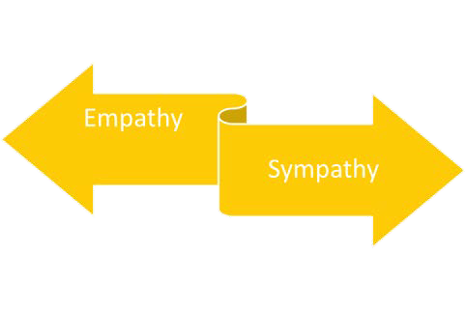
What is the difference between empathy and sympathy?

Slide 7

Video: Empathy and Sympathy
https://www.youtube.com/watch?v=1Evwgu369Jw

Slide 8
Empathy
Sympathy
May drive disconnection
Feeling pity or sorrow for the hardships of another person
Fuels connection
Stays out of judgement
Recognizes emotions in others
Communicates that emotion
Feels with people / connects with something inside yourself that knows that feeling

Slide 9
Reflective Listening
Reflective listening is a communication strategy involving two key steps:
Seeking to understand a speaker's idea, then
Offering the idea back to the speaker, to confirm the idea has been understood correctly by you.

Slide 10
When you are listening reflectively, you are able to let the other person know you have absorbed their main points by…
Repeating: Repeat back, word for word, what you just heard
Rephrasing: Repeat back what you just heard in your own words
Reflecting feelings and meanings: Listen closely to the other person and reflect the content of their message as well as their emotional state in your own words

Slide 11
Points to Remember when Listening Reflectively:
Requires fully listening to the person with your presence, your ears, mind, eyes, and heart
Allows the speaker to express him or herself without interruption
Keeps your focus on the what the listener is saying, rather than what your response will be to the listener. Listening to understand, not listening to respond
Minimizes distractions

Slide 12
Benefits of Reflective Listening
Helps the speaker feel listened to and valued
Encourages the speaker to offer more helpful information and details
Helps the listener to fully hear what the speaker is saying without imposing his/her own agenda
Allows the listener to confirm the accuracy of what the speaker has said

Slide 13

Feedback Tool
A tool for indicating when things are going in the right direction or, for redirecting problem performance
Provides guidance by supplying information in a useful manner

Slide 14
Feedback – Things to Remember
Focus on behaviors rather than inferences
Be descriptive, not judgmental
Share specifics rather than generalizations
Share ideas
Explore alternatives
Limit amount of feedback at one time
Be respectful, confidential
Be aware of your own biases

Slide 15
Formal Feedback
Positive feedback: Benefits
Constructive feedback: Benefits
Negative feedback: Detriments
feelings of success
feelings of at least partial success
maintains motivation to learn
desired performance through supportive language, correcting unsatisfactory performance
discouraging
reduces motivation
focuses on what not to do
motivation to learn
reinforce desired performance

