Slide 1

OBJECTIVES
Define cultural terms and their impact on apprenticeship
Develop a shared understanding of the elements of culture and their impact on verbal and non-verbal communication
Module 5:
Cultural Competence and Communication

Slide 2
What is Culture?
Thoughts, communications, actions, customs, beliefs, values, and institutions of racial, ethnic, religious, or social groups.
Source: Missouri People to People Training Manual, 2008

Slide 3
What is Cultural Awareness?
A general understanding of what another group is like and how it functions.
What is Cultural Sensitivity?
Accepting and open to the differences that exist between cultures without assigning judgments (good/bad, right/wrong) to those differences.This usually involves internal changes in one’s attitudes and values.
Source: Missouri People to People Training Manual, 2008

Slide 4

Cultural Identity
What are some factors that
address a person’s cultural identity?
Language
Ethnicity or race
Geography
Socioeconomic status
Age
Gender
Sexual Orientation
Disability
Religion

Slide 5
Cultural Iceberg Video
https://www.youtube.com/watch?v=woP0v-2nJCU

Slide 6
What is the difference?
Implicit Presentation of Culture
Explicit Presentation of Culture

Slide 7
Presentation of Culture
Explicit
Easy to see, taste or hear
It is only the tip of the iceberg
Implicit
Where the majority of culture lies
It is not immediately visible
It can influence behavior, values, feelings and thoughts

Slide 8
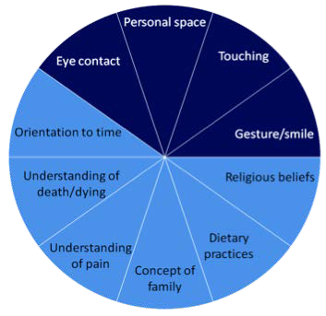
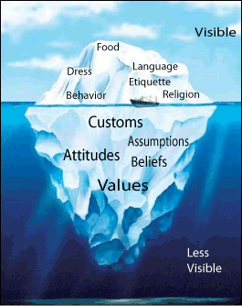
Cultural Iceberg & Wheel
Observable Behavior
Non-Observable Behavior

Slide 9

































Considerations for Inter-Cultural Communication – See Module 5 Handout for Details
Timing of verbal exchanges and silence
Social space
Touching
Volume of voice
Smiles
Eye contact
Gestures

Slide 10
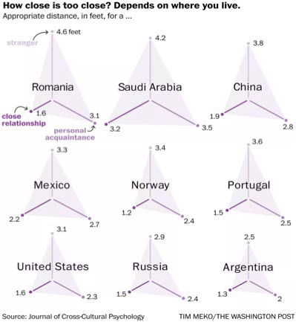

Slide 11
Considerations on Communicating with Apprentices who are not Fluent in English
Use shorter, common words and be concise. Repeat yourself as needed, or use pictures and gestures to get your point across.
Speak slowly – but not too slowly. Remember, the person is an adult and should not be spoken to as a child.
Accommodate language differences by bringing an interpreter or suggesting a that a mentor be assigned who speaks the Apprentices’ language.
Pair fluent and non-fluent Apprentices for training, if possible and if a translator is not available

