Slide 1
OBJECTIVES
Develop an understanding of effective communication for Mentors
Develop guidelines for speaking and listening in a mentorship environment
Distinguish the components and the impact of verbal and non-verbal communication
Module 6:
Elements of Communication

Slide 2
What influences how we communicate?
Is it what you say?
Is it your tone of voice?
Is it your body language and facial expression?

Slide 3
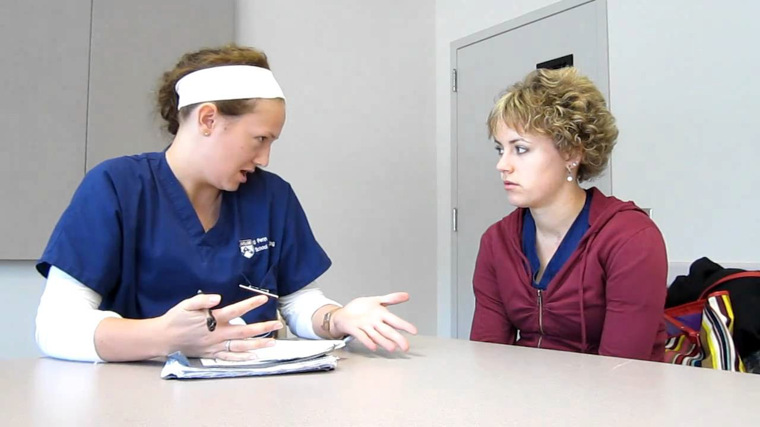
Consider these questions as you watch this video example of poor communication.
https://www.youtube.com/watch?v=W1RY_72O_LQ

Slide 4
2 Ways messages are communicated: Verbal & Non-verbal
Words
Tone of voice
Body language

Slide 5
DOs & DON’Ts of Verbal Communication
DO use the person’s name
DO validate what the person says
DON’T interrupt the person
DON’T give the person unsought or unrelated advice
DON’T talk about yourself
DON’T use terms of endearment
DON’T tell the person you “know how they feel”

Slide 6
Tips for Effective Verbal Communication
Use language that the apprentice understands
Summarize your instructions or key points
Explain things in a kind, understandable way
Adapted from Colorado Patient Navigator Training program http://www.patientnavigatortraining.org/

Slide 7
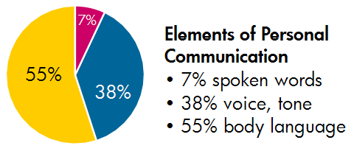
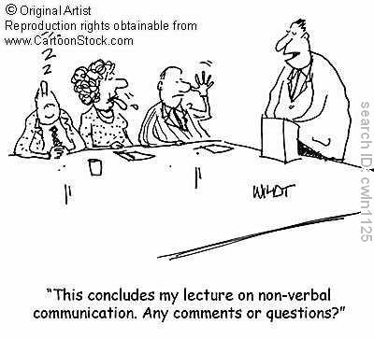
Sometimes it’s more about what you don’t say!
When face-to-face, the majority of your message (55%) is communicated non-verbally.

Slide 8
Tone of Voice
How does the tone of your voice impact communication?
Tone of voice is a combination of: Volume, Pitch, Inflection and Rate

Slide 9
Be aware of what your tone conveys
Maintain a demeanor that is warm and friendly
Maintain an attitude of confidence and professionalism
Don’t shout at a person whose primary language is not English in an effort to be understood
Maintain a calm and reassuring tone
Speak clearly and adjust your volume or tone as necessary based on people’s reactions

Slide 10
Non-verbal Communication /Body Language
Body language is the process of communicating nonverbally through gestures and movements

Slide 11
Set up the ideal environment for communication
If possible, ensure an environment with minimal distractions when speaking with someone
Present yourself in a professional manner (i.e. attire…)
Offer the person a warm greeting
Sit down when speaking to someone
Match the persons eye level when speaking

Slide 12
Set up the ideal environment for communication
Maintain a posture that is relaxed, but attentive
When seated, lean slightly forward and be still, but not motionless
Encourage the person, when necessary, with affirmative head nods as opposed to listening without expression
o This can help make the person feel understood and empathized with

Slide 13
Be aware of the other person’s body language, tone and non- verbal communications
Recognize the different forms of nonverbal communication a person may display
Try to avoid making assumptions and try to confirm the proper interpretation of a person’s nonverbal behaviors
Observe the person’s reactions toward you. This will provide feedback about your own nonverbal behaviors.
Adapted from: Kelly McCorry Ph. D., L., Mason, J. Communication Skills for the Healthcare
Professional, Lippincott Williams & Wilkens, 2011.

