Slide 1

OBJECTIVES
Become familiar with overall course
outline and overarching objectives of the mentorship training
Acknowledge and share the experience of participants
Become familiar with the basic history, values, and structures of apprenticeship
Become familiar with the basic structures and values of mentorship
Session 1:
Introduction to Registered Apprenticeship and Mentorship

Slide 2
Learning Outcomes
At the end of the course, Mentors will:
Understand the basics of Registered Apprenticeship
Identify ways Mentors can use their role to help Apprentices become successful in their occupation
Understand principles of adult learning
Understand how to apply assessment to the mentorship role
Acknowledge the impact of culture on interdisciplinary team interactions
Apply communication strategies with Apprentices including Teach Back and Reflective Listening
Explore and demonstrate effective Problem Solving and Conflict Resolution strategies
6

Slide 3
Class Guidelines
Respect each other’s experiences and opinions
Share your thoughts
Have FUN!!
7

Slide 4

Activity: Experience Tally

Slide 5
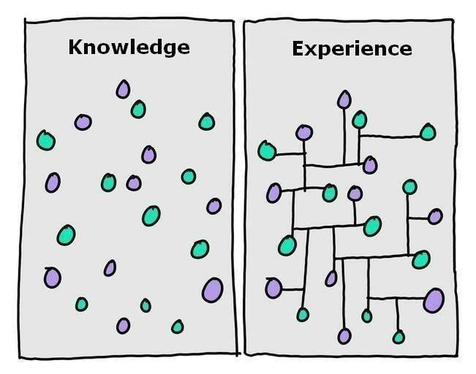
Activity: Knowledge and Experience
9

Slide 6
What does the word
“Apprentice”
mean to you?
10

Slide 7
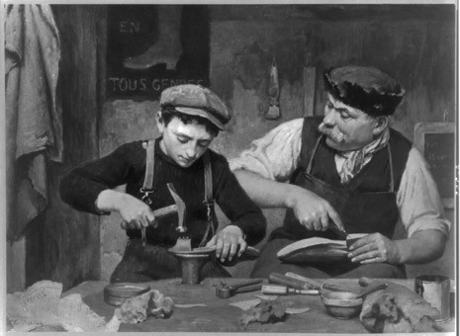
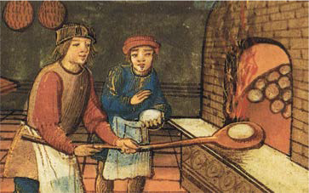
Apprenticeship Throughout History
A system of education to ensure competence, quality, and pride of work
Apprenticeship as a system of training originated centuries ago
Craft Apprentices
A guild system to support and sustain traditional occupations
11

Slide 8
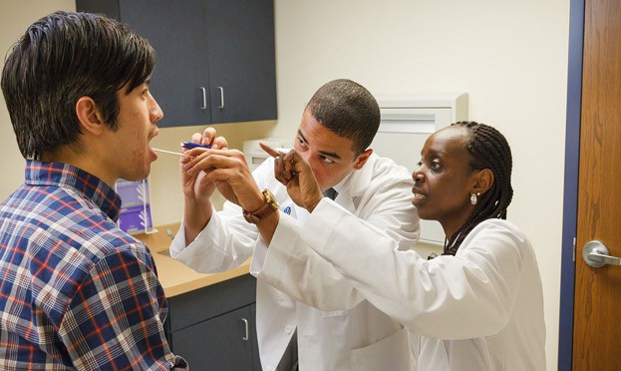
Modern Registered Apprenticeships
Today, the apprenticeship model is being implemented in new occupations including healthcare and other service industries
Peer Mentors, preceptors, and supervisors provide on-the-job training to ensure that Apprentices demonstrate core competencies and professional knowledge
Classroom instruction complements workplace training
12

Slide 9
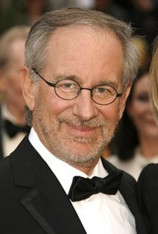
Mentorship
“A structured process by which employees are grouped to work together
to develop essential skills
relevant to job performance and personal growth”
– Ann Haney, The Role of Mentorship in the Workplace
“The delicate balance of mentoring someone is not creating them in your own image,
but giving them the opportunity to create themselves”
- Steven Spielberg
14

Slide 10
Activity:
Who has Mentored You?
16

