Slide 1
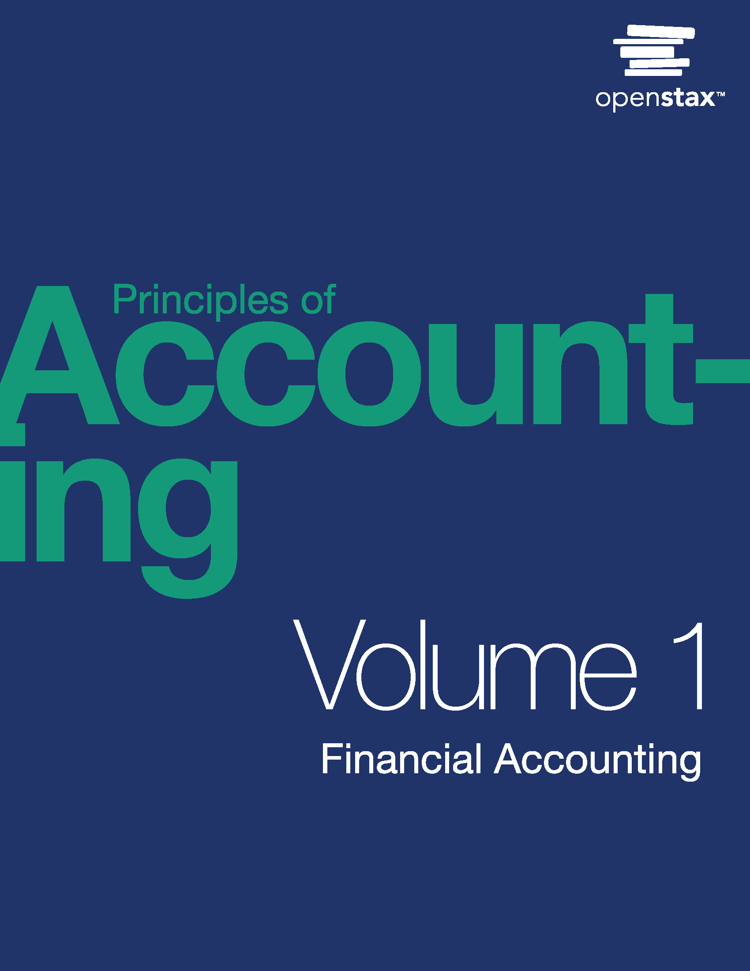
Principles of Accounting, Volume 1: Financial Accounting
Chapter 2 INTRODUCTION TO FINANCIAL STATEMENTS

Slide 2
Chapter Outline
2.1 Describe the Income Statement, Statement of Owner’s Equity, Balance Sheet, and Statement of Cash Flows, and How They Interrelate
2.2 Define, Explain, and Provide Examples of Current and Noncurrent Assets, Current and Noncurrent Liabilities, Equity, Revenues, and Expenses
2.3 Prepare an Income Statement, Statement of Owner’s Equity, and Balance Sheet

Slide 3
Module 2.1 Describe the Income Statement, Statement of Owner’s Equity, Balance Sheet, and Statement of Cash
In business—and accounting in particular—it is necessary to distinguish the business entity from the individual owner(s). Accountants should only record business transactions in business records. This separation is also reflected in the legal structure of the business.
Types of Business Structures
Table 2.1
 | Sole Proprietorship | Partnership | Corporation
Number of Owners | Single individual | Two or more individuals | One of more owners
Ease of Formation | Easier to form | Harder to form | Difficult to form
Ability to Raise Capital | Difficult to raise capital | Harder to raise capital | Easier to raise capital
Liability Risk | Unlimited liability | Unlimited liability | Limited liability
Taxation Consideration | Single taxation | Single taxation | Double taxation
Notes:
Teacher Notes: The personal transactions of the owners, employees, and other parties connected to the business should not be recorded in the organization’s records.

Slide 4
Financial Statements
All businesses, regardless of legal structure, generate financial statements:
Income Statement
Statement of Owner’s Equity
Balance Sheet
Statement of Cash Flows
Purpose of financial statements:
Stakeholders, such as investors, creditors, regulators, and employees are interested in the performance of an organization for various reasons, but the common goal of using the financial statements is to understand the information each contains that is useful for making financial decisions.
Notes:
Teacher Notes: Each of these statements will be discussed in detail in the upcoming slides.

Slide 5
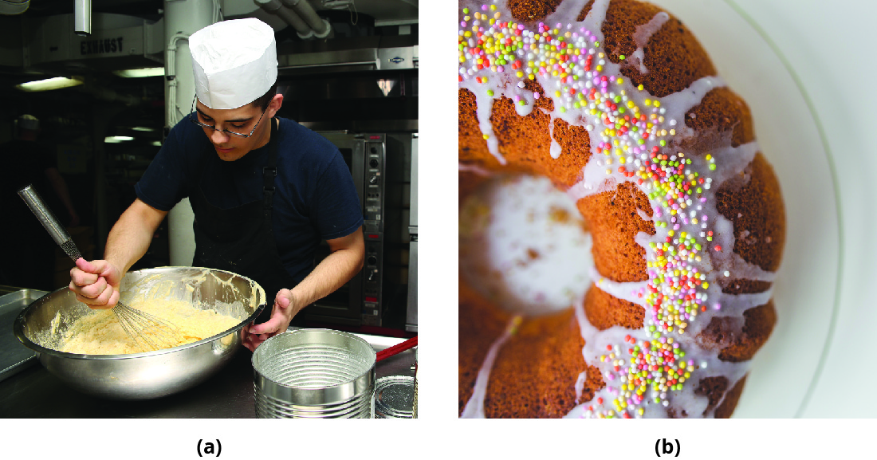
Figure 2.5
Baking requires an understanding of the different ingredients, how the ingredients are used, and how the ingredients will impact the final product (a). If used correctly, the final product will be beautiful and, more importantly, delicious, like the cake shown in (b). In a similar manner, the study of accounting requires an understanding of how the accounting elements relate to the final product—the financial statements. (credit (a): modification of “U.S. Navy Culinary Specialist Seaman Robert Fritschie mixes cake batter aboard the amphibious command ship USS Blue Ridge (LCC 19) Aug. 7, 2013, while underway in the Solomon Sea 130807-N-NN332-044” by MC3 Jarred Harral/Wikimedia Commons, Public Domain; credit (b): modification of “Easter Cake with Colorful Topping” by Kaboompics .com/Pexels, CC0)

Slide 6
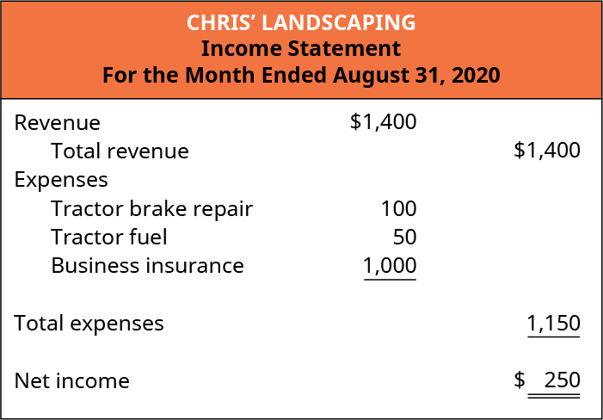
Income Statement
The income statement shows the organization’s financial performance for a given period of time.
Revenue: the value of goods and services the organization sold or provided to customers
Expenses: a cost associated with providing goods or services to customers
Net Income (Net Loss): determined by comparing revenues and expenses
Modified for PPT.

Slide 7
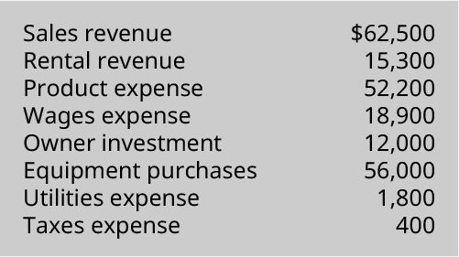
Sample Exercise
EA9. Prepare an income statement using the following information for DL Enterprises for the month of July 2018.

Slide 8
Net Income
Net income can be expressed in general form as:

Slide 9
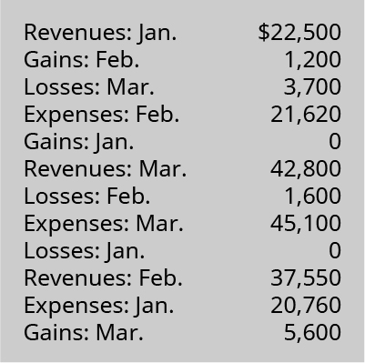
Sample Problem
PA1. The following information is taken from the records of Baklava Bakery for the year 2019.
Calculate net income or net loss for January.
Calculate net income or net loss for February.
Calculate net income or net loss for March.
For each situation, comment on how a stakeholder might view the firm’s performance. (Hint: Think about the source of the income or loss.)

Slide 10
Your Turn: Coffee Shop Products
Think about the coffee shop in your area. Identify items the coffee shop sells that would be classified as revenues. Remember, revenues for the coffee shop are related to its primary purpose: selling coffee and related items. Or, better yet, make a trip to the local coffee shop and get a first-hand experience.

Slide 11
Your Turn: Coffee Shop Expenses
While thinking about or visiting the coffee shop in your area, look around (or visualize) and identify items or activities that are the expenses of the coffee shop. Remember, expenses for the coffee shop are related to resources consumed while generating revenue from selling coffee and related items. Do not forget about any expenses that might not be so obvious—as a general rule, every activity in a business has an associated cost.

Slide 12
Gains and Losses
Revenues and expenses occur from the doing what the business is in business to do. For example, Chris is in the landscaping business, so revenues would be from performing landscape services and expenses would be the costs associated with generating those revenues.
Chris’s business, as well as any other business, is likely to periodically have gains and losses in addition to revenues and expenses. Here is how gains and losses affect the income statement:
Gains result from selling ancillary business items for more than the items are worth, such as buildings, land, or equipment that help support the business’s operations.
Losses result from selling ancillary business items for less than the items are worth.
It is obvious that gains have the same effect on Net Income as revenues; they increase net income. Losses have the same effect as expenses; they decrease net income.
Modified for PPT.

Slide 14
Sample Exercise
EA1. For each independent situation below, calculate the missing values.

Slide 15
Statement of Owner’s Equity
The statement of owner’s equity, the second financial statement created by accountants, shows how the equity (or value) of the organization has changed over time. Similar to the income statement, the statement of owner’s equity is for a specific period of time. Equity is the value of an item that remains after considering what is owed for that item.
Beginning Balance is $0 because this is the first month of business.
Net Income is added to the beginning balance; the first part of how the financial statements interrelate.
Modified for PPT.
Notes:
Teacher Notes: Equity explanation using something students can easily understand:
House value = $400,000
Mortgage owed = $250,000
Equity = $150,000
The same concept applies to companies; equity represents the value, or net worth, of the company.

Slide 16
Possible Changes to Owner’s Equity Other than Net Income
Investments by owners: represent an exchange of cash or other assets for which the investor is given an ownership interest in the organization.
Distributions to owners: periodic rewards issued to the owners in the form of cash or other assets. Distributions to owners represent some of the value (equity) of the organization.

Slide 17
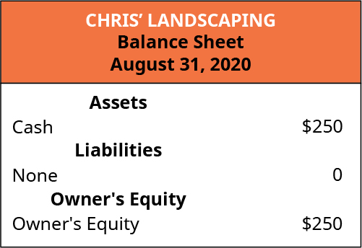
Figure 2.2
Balance sheet: a statement that lists what the organization owns (assets), what it owes (liabilities), and what it is worth (equity) on a specific date.
Assets: resources used to generate revenue
Liabilities: amounts owed to others (called creditors)
Equity: refers to book value or net worth, this amount is the ending balance of the Statement of Owner’s Equity
“Balance Sheet for Chris’ Landscaping.” Modified for PPT. (attribution: Copyright, Rice University, OpenStax, under CC BY-NC-SA 4.0 license)

Slide 18
The income statement, statement of owner’s equity, and the balance sheet are interrelated. Each statement provides unique information, but the statements are connected.
Modified for PPT.

Slide 19
Statement of Cash Flows
Statement of cash flows is a statement that lists the cash inflows and cash outflows for the business for a period of time.
There are two “bases” of accounting. A basis indicates when revenues and expenses will be recorded.
Cash basis accounting: transactions (i.e., a sale or a purchase) are not recorded in the financial statements until there is an exchange of cash. This type of accounting is permitted for nonprofit entities and small businesses that elect to use this type of accounting.
Accrual basis accounting: transactions are generally recorded in the financial statement when the transactions occur, and not when paid; although in some situations, the two events could happen on the same day.
Notes:
Teacher Notes: Cash flow specifics and presentation will be covered when we have more information to put on the statement of cash flows. To “record” a transaction means to list the transaction in the accounting system so that it will appear on the appropriate financial statements.

Slide 20
Transactions by Cash Basis versus Accrual Basis of Accounting
Table 2.2 Businesses often sell items for cash as well as on account, where payment terms are extended for a period of time (for example, thirty to forty-five days). Likewise, businesses often purchase items from suppliers (also called vendors) for cash or, more likely, on account. Under the cash basis of accounting, these transactions would not be recorded until the cash is exchanged. In contrast, under accrual accounting the transactions are recorded when the transaction occurs, regardless of when the cash is received or paid.
Transaction | Under Cash Basis Accounting | Under Accrual Basis Accounting
$200 sale for cash | Recorded in financial statements at time of sale | Recorded in financial statements at time of sale
$200 sale on account | Not recorded in financial statements until cash is received | Recorded in financial statements at time of sale
$160 purchase for cash | Recorded in financial statements at time of purchase | Recorded in financial statements at time of purchase
$160 purchase on account | Not recorded in financial statements until cash is paid | Recorded in financial statements at time of purchase

Slide 21
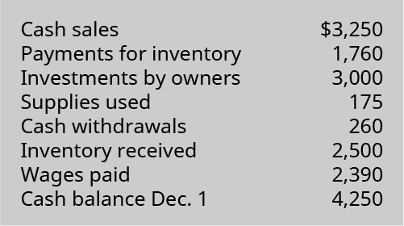
Sample Exercise
EA7. Forest Company had the following transactions during the month of December. What is the December 31 cash balance?

Slide 22
Module 2.2 Define, Explain, and Provide Examples of Current and Noncurrent Assets, Current and Noncurrent
Current versus noncurrent distinction
An asset that will be used or consumed in one year or less will be classified as a current asset. If the asset will be used or consumed over more than one year, it is classified as a noncurrent asset.
A liability that will be settled in one year or less (generally) is classified as a current liability, while a liability that is expected to be settled in more than one year is classified as a noncurrent liability.

Slide 23
Current versus Noncurrent Examples
Current Assets Noncurrent Assets
Cash Buildings, Land, Equipment
Accounts Receivable Notes Receivable
Inventory Patents
Current Liabilities Noncurrent Liabilities
Accounts Payable Notes Payable
Notes Payable
Notes:
Teacher Notes: These are a few of the accounts that would fall under each of these headings.

Slide 24
Why Current versus Noncurrent Distinction Matters
Stakeholders use financial information to make decisions. Providing the amounts of the assets and liabilities answers the “what” question for stakeholders (that is, it tells stakeholders the value of assets), but it does not answer the “when” question for stakeholders.
For example, knowing that an organization has $1,000,000 worth of assets is valuable information, but knowing that $250,000 of those assets are current and will be used or consumed within one year is more valuable to stakeholders. Likewise, it is helpful to know the company owes $750,000 worth of liabilities, but knowing that $125,000 of those liabilities will be paid within one year is even more valuable. In short, the timing of events is of particular interest to stakeholders.

Slide 25
Think It Through: Borrowing
When money is borrowed by an individual or family from a bank or other lending institution, the loan is considered a personal or consumer loan. Typically, payments on these types of loans begin shortly after the funds are borrowed. Student loans are a special type of consumer borrowing that has a different structure for repayment of the debt. If you are not familiar with the special repayment arrangement for student loans, do a brief internet search to find out when student loan payments are expected to begin.
Now, assume a college student has two loans—one for a car and one for a student loan. Assume the person gets the flu, misses a week of work at his campus job, and does not get paid for the absence. Which loan would the person be most concerned about paying? Why?

Slide 26
Equity and Legal Structure
Business Legal Structure | Term for Owner’s Investment | Term for Owner’s Distributions | Terminology for Equity
Sole proprietorship | Capital | Withdrawal | Owner’s capital
Partnership | Capital | Withdrawal | Partner’s capital
Corporation | Common stock | Dividend | Retained earnings
Notes:
Teacher Notes: The essence of these transactions remains the same: organizations become more valuable when owners make investments in the business and the businesses earn a profit (net income). Organizations become less valuable when owners receive distributions (dividends) from the organization and the businesses incur a loss (net loss).

Slide 27
Balance Sheet Equation
To help understand the balance sheet equation concept, assume a family purchased a home valued at $200,000 and made a down payment of $25,000 while financing the remaining balance with a $175,000 bank loan. The accounting equation would be:
Notes:
Figure F02_02_AcctEq_img
Teacher Notes: Obviously a business has many assets and many liabilities, but the basic concept exhibited here will hold as we move forward to see how the balance sheet equation works for business entities.

Slide 28
Your Turn: The Accounting Equation
On a sheet of paper, use three columns to create your own accounting equation. In the first column, list all of the things you own (assets). In the second column, list any amounts owed (liabilities). In the third column, using the accounting equation, calculate, you guessed it, the net amount of the asset (equity). When finished, total the columns to determine your net worth. Hint: do not forget to subtract the liability from the value of the asset.
Here is something else to consider: is it possible to have negative equity? It sure is . . . ask any college student who has taken out loans. At first glance there is no asset directly associated with the amount of the loan. But is that, in fact, the case? You might ask yourself why make an investment in a college education—what is the benefit (asset) to going to college? The answer lies in the difference in lifetime earnings with a college degree versus without a college degree. This is influenced by many things, including the supply and demand of jobs and employees. It is also influenced by the earnings for the type of college degree pursued. (Where do you think accounting ranks?)

Slide 29
Figure 2.4
Notice that assets have the + sign (increases) on the right side of the columns, while liabilities and owner’s equity have the + sign (increases) on the left side of the columns.
Graphical Representation of the Accounting Equation. Both assets and liabilities are categorized as current and noncurrent. Also highlighted are the various activities that affect the equity (or net worth) of the business. (attribution: Copyright Rice University, OpenStax, under CC BY-NC-SA 4.0 license)
Notes:
Teacher Notes: This will be developed further in Chapter 3.

Slide 30
Transactions that Affect the Value (Equity) of the Organization | Transactions that DO NOT Affect the Value (Equity) of the Organization
Revenues (increase equity) | Exchanges of assets for assets
Expenses (decrease equity) | Exchanges of liabilities for liabilities
Gains (increase equity) | Acquisitions of assets by incurring liabilities
Losses (decrease equity) | Settlements of liabilities by transferring assets
Investments by owners (increase equity)
Distributions to owners (decrease equity)
Changes in assets and liabilities can either increase or decrease the value (equity) of the organization depending on the net result of the transaction.

Slide 31
Module 2.3 Prepare an Income Statement, Statement of Owner’s Equity, and Balance Sheet
Elements of the financial statements: Those categories or accounts that accountants use to record transactions and prepare financial statements.
Revenue: value of goods and services the organization sold or provided
Expenses: costs of providing the goods or services for which the organization earns revenue
Gains: similar to revenue, but relate to “incidental or peripheral” activities of the organization
Losses: similar to expenses, but related to “incidental or peripheral” activities of the organization
Assets: items the organization owns, controls, or has a claim to
Liabilities: amounts the organization owes to others (also called creditors)
Equity: net worth (or net assets) of the organization
Investment by owners: cash or other assets provided to the organization in exchange for an ownership interest
Distribution to owners: cash, other assets, or ownership interest (equity) provided to owners
Comprehensive income: defined as the “change in equity of a business enterprise during a period from transactions and other events and circumstances from nonowner sources” (SFAC No. 6, p. 21). While further discussion of comprehensive income is reserved for intermediate and advanced studies in accounting, it is worth noting that comprehensive income has four components, focusing on activities related to foreign currency, derivatives, investments, and pensions.

Slide 32
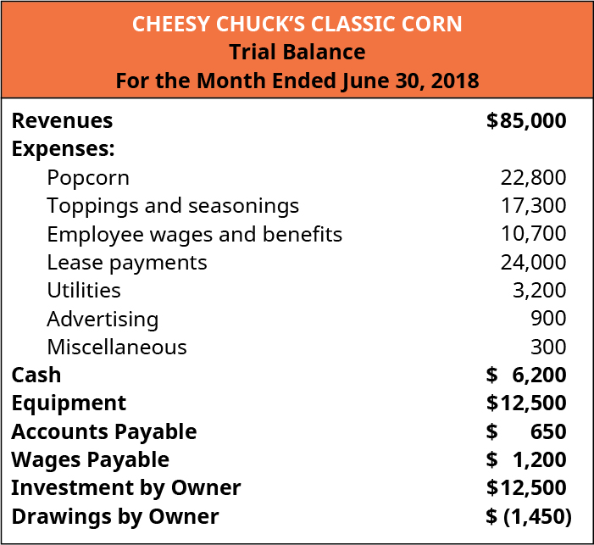
Figure 2.6
A trial balance is a listing of all accounts and their balances.
Income Statement Accounts
Balance Sheet Accounts
Owner’s Equity Accounts
Trial Balance for Cheesy Chuck’s Classic Corn. Accountants record and summarize accounting information into accounts, which help to track, summarize, and prepare accounting information. This table is a variation of what accountants call a “trial balance.” A trial balance is a summary of accounts and aids accountants in creating financial statements. Modified for PPT. (attribution: Copyright Rice University, OpenStax, under CC BY-NC-SA 4.0 license)

Slide 33
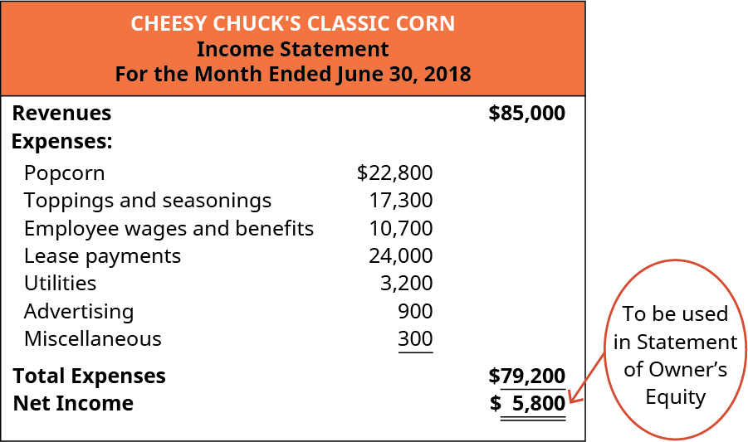
Figure 2.7
Income Statement for Cheesy Chuck’s Classic Corn. The income statement for Cheesy Chuck’s shows the business had Net Income of $5,800 for the month ended June 30. This amount will be used to prepare the next financial statement, the statement of owner’s equity. (attribution: Copyright Rice University, OpenStax, under CC BY-NC-SA 4.0 license)

Slide 34
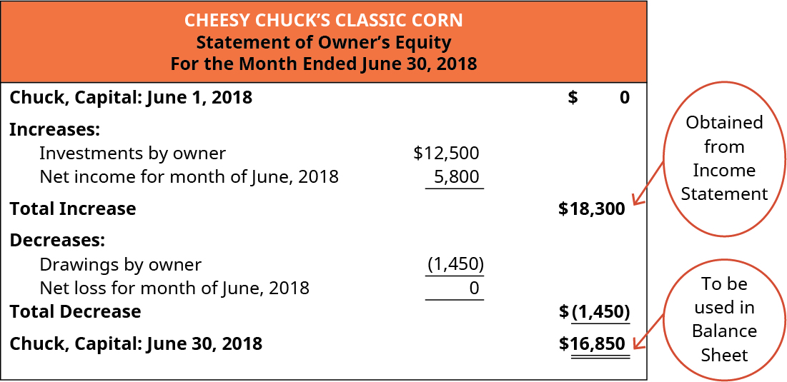
Figure 2.8
Statement of Owner’s Equity for Cheesy Chuck’s Classic Corn. The statement of owner’s equity demonstrates how the net worth (also called equity) of the business changed over the period of time (the month of June in this case). Notice the amount of net income (or net loss) is brought from the income statement. In a similar manner, the ending equity balance (Capital for Cheesy Chuck’s because it is a sole proprietorship) is carried forward to the balance sheet. (attribution: Copyright Rice University, OpenStax, under CC BY-NC-SA 4.0 license)

Slide 35
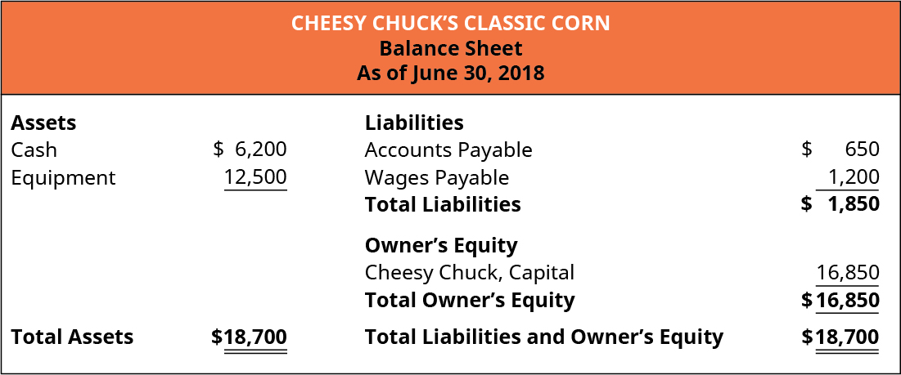
Figure 2.9
Obtained from Statement of Owner’s Equity
Balance Sheet for Cheesy Chuck’s Classic Corn. The balance sheet shows what the business owns (Assets), owes (Liabilities), and is worth (equity) on a given date. Notice the amount of Owner’s Equity (Capital for Cheesy Chuck’s) was brought forward from the statement of owner’s equity. Modified for PPT. (attribution: Copyright Rice University, OpenStax, under CC BY-NC-SA 4.0 license)

Slide 36
Financial Ratios
In addition to reviewing the financial statements in order to make decisions, owners and other stakeholders also utilize financial ratios to assess the financial health of the organization. There are various ratio categories and different ratios within each of those categories. One category of ratios is liquidity ratios.
Liquidity refers to the business’s ability to convert assets into cash in order to meet short-term cash needs. Examples of the most liquid assets include accounts receivable and inventory. These assets can be turned into cash more quickly than land or buildings, for example.
Working capital is current assets minus current liabilities; it is not a ratio, but it is used to assess the dollar amount of assets a business has available to meet its short-term liabilities.
The current ratio is closely related to working capital; it represents the current assets divided by current liabilities. The current ratio utilizes the same amounts as working capital (current assets and current liabilities) but presents the amount in ratio, rather than dollar, form.
Current Ratio = Current Assets ÷ Current Liabilities
Notes:
Teacher Notes: A positive working capital amount is desirable and indicates the business has sufficient current assets to meet short-term obligations (liabilities) and still has financial flexibility. A negative amount is undesirable and indicates the business should pay particular attention to the composition of the current assets (that is, how liquid the current assets are) and to the timing of the current liabilities.
A current ratio of greater than one indicates that the firm has the ability to meet short-term obligations with a buffer, while a ratio of less than one indicates that the firm should pay close attention to the composition of its current assets as well as the timing of the current liabilities.

Slide 37
Summary
Financial statements provide financial information to stakeholders to help them in making decisions.
There are four financial statements: income statement, statement of owner’s equity, balance sheet, and statement of cash flows.
The income statement measures the financial performance of the organization for a period of time. The income statement lists revenues, expenses, gains, and losses, which make up net income (or net loss).
The statement of owner’s equity shows how the net worth of the organization changes for a period of time. In addition to showing net income or net loss, the statement of owner’s equity shows the investments by and distributions to owners.
The balance sheet shows the organization’s financial position on a given date. The balance sheet lists assets, liabilities, and owners’ equity.
The statement of cash flows shows the organization’s cash inflows and cash outflows for a given period of time. The statement of cash flows is necessary because financial statements are usually prepared using accrual accounting, which records transactions when they occur rather than waiting until cash is exchanged.

Slide 38
Summary (continued)
Three broad categories of legal business structures are sole proprietorship, partnership, and corporation, with each structure having advantages and disadvantages.
The accounting equation is Assets = Liabilities + Owner’s Equity. It is important to the study of accounting because it shows what the organization owns and the sources of (or claims against) those resources.
Owners’ equity can also be thought of as the net worth or value of the business. There are many factors that influence equity, including net income or net loss, investments by and distributions to owners, revenues, gains, losses, expenses, and comprehensive income.
There are ten financial statement elements: revenues, expenses, gains, losses, assets, liabilities, equity, investments by owners, distributions to owners, and comprehensive income.
There are standard conventions for the order of preparing financial statements (income statement, statement of owner’s equity, balance sheet, and statement of cash flows) and for the format (three-line heading and columnar structure).
Financial ratios, which are calculated using financial statement information, are often beneficial to aid in financial decision-making. Ratios allow for comparisons between businesses and determining trends between periods within the same business.

Slide 39
This OpenStax ancillary resource is © Rice University under a CC-BY-NC-SA 4.0 International license; it may be reproduced or modified for noncommercial purposes only but must be attributed to OpenStax, Rice University and any changes must be noted. Any adaptation must be shared under the same type of license.

